Slide 1
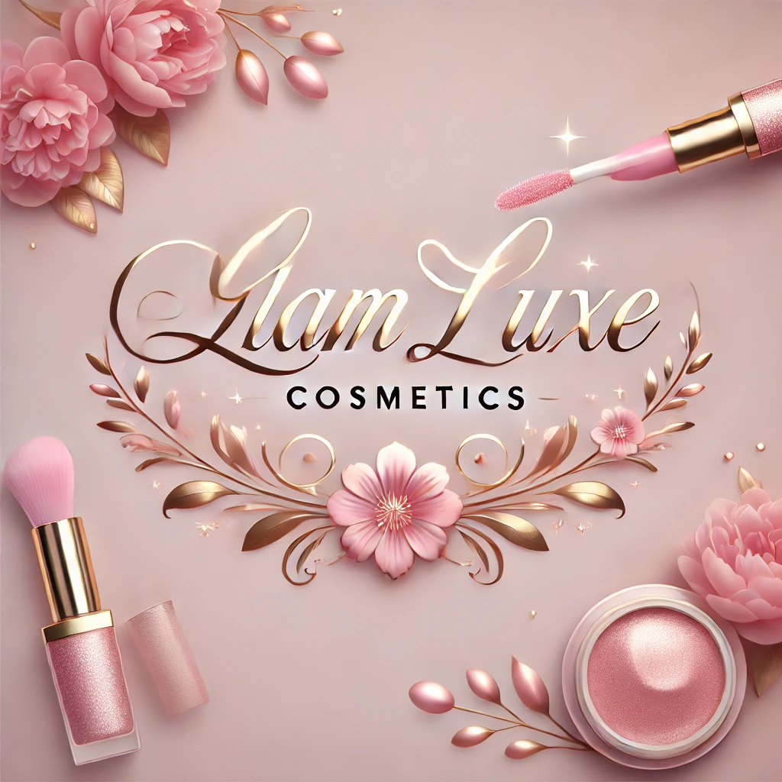

Slide 2
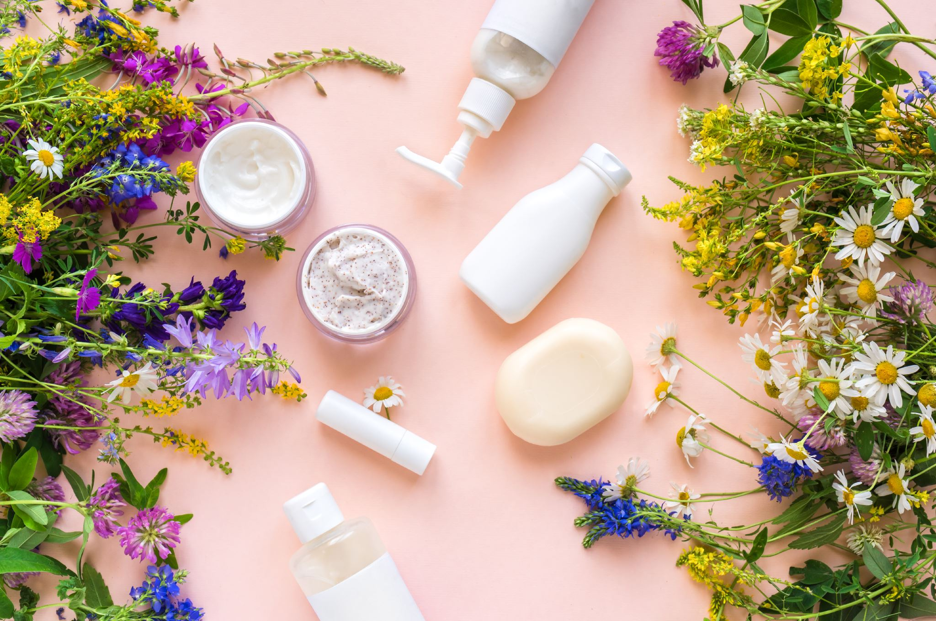
Presentation
GlamLuxe Cosmetics operates in the beauty and cosmetics industry, focusing on producing luxury lipsticks that are cruelty-free and made from natural ingredients. The company’s products are designed to suit diverse skin tones and cater to various occasions, offering customers high-quality, empowering beauty products. GlamLuxe Cosmetics provides a range of beauty products while also focusing on delivering excellent customer support and digital engagement through channels like email marketing and social media.

Slide 3
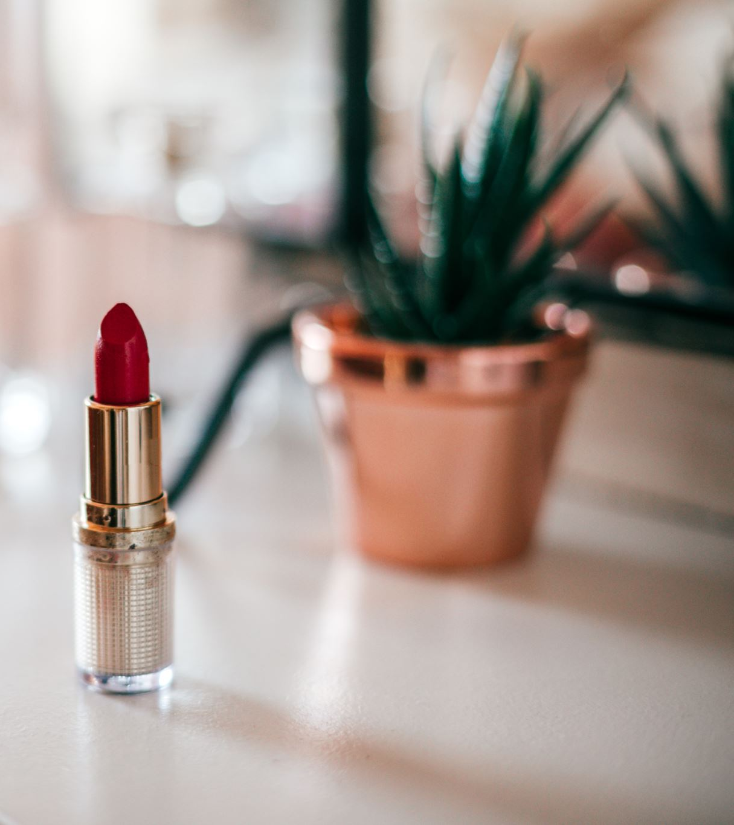
Company Size:
Medium-Sized – GlamLuxe is a growing brand in the cosmetics industry, expanding its customer base and digital presence.

Slide 4
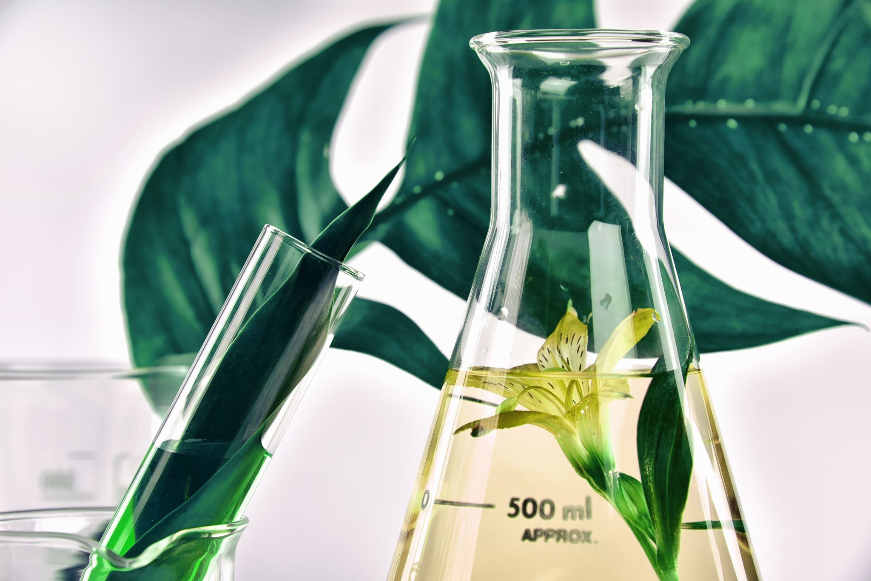
Other Important Information:
Keywords:
luxury cosmetics, cruelty-free, natural ingredients, inclusive shades, beauty empowerment, eco-friendly.
Example of Products:
GlamLuxe offers a range of lipsticks with shades such as "Rose Radiance," "Midnight Velvet," and "Sunset Bliss." These lipsticks come in sleek, matte-finish packaging that enhances the luxury appeal.
Technical Parameters:
Formulation:
Paraben-free, vegan, long-lasting wear(up to 12 hours).
Ingredients:
Natura loils, sheabutter, andplant-based pigments.
Packaging:
Eco-friendly, recyclable materials, with a design focus on minimalistic luxury aesthetics.

Slide 5

GlamLuxe Cosmetics is dedicated to standing out in the beauty industry with high-quality, sustainable, and inclusive products that cater to a diverse customer base.
The company's focus on digital engagement will support its goal of reaching more consumers through sophisticated and targeted marketing strategies.
GlamLuxe Cosmetics is a vibrant, luxury beauty brand making waves in the cosmetics industry.

Slide 6
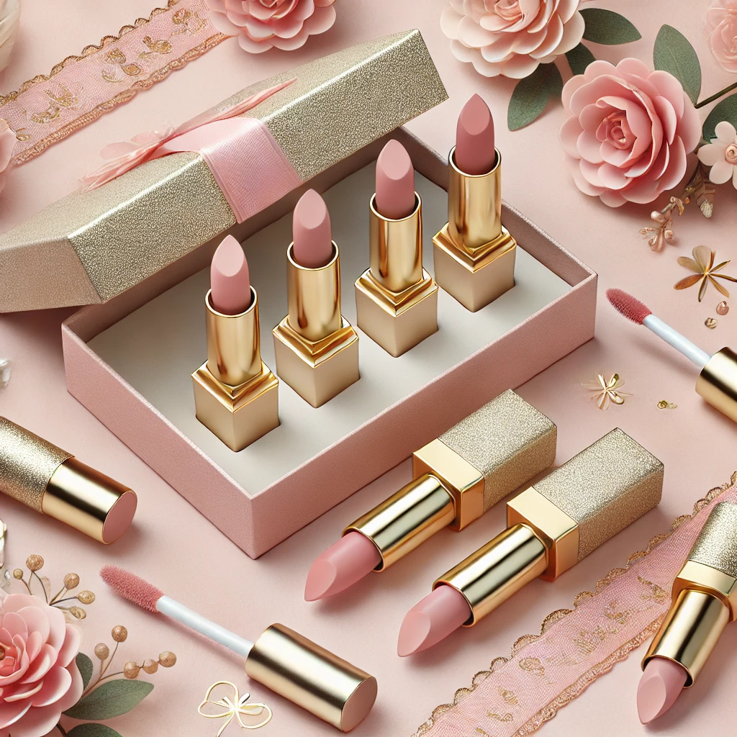
Known for its high-quality lipsticks crafted from cruelty- free, natural ingredients, GlamLuxe has positioned itself as a brand that merges luxury with conscious beauty.
Its mission is to empower customers by offering a wide array of shades suitable for all skin tones and designed for both everyday wear and special occasions.
Each product emphasizes GlamLuxe's commitment to both quality and inclusivity, appealing to a broad audience that values beauty without compromise.

Slide 7
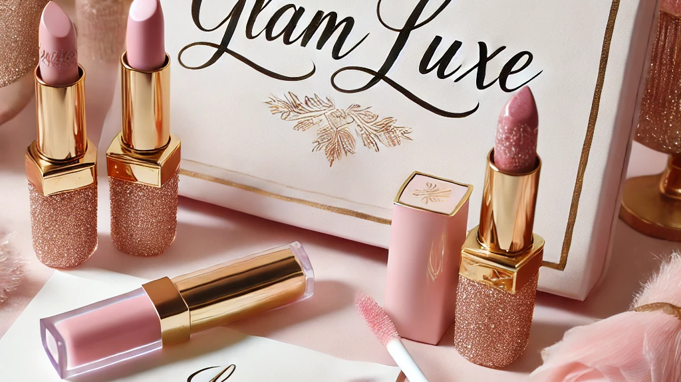
GlamLuxe is a medium-sized, rapidly growing company that initially made a name for itself through its eco-friendly, vegan lipsticks.
As the brand's customer base expands, it’s also refining its digital presence to better connect with its audience. Embracing marketing automation is a key next step, aimed at enhancing efficiency across email marketing, social media, and customer support, helping GlamLuxe manage and scale its customer interactions in a way that feels personal and engaging.

Slide 8

This focus on digital marketing reflects GlamLuxe’s ambition to grow within an industry that is not only competitive but increasingly focused on sustainability and inclusivity.
By prioritizing both innovation and customer experience, GlamLuxe Cosmetics is positioning itself as a go-to brand for customers seeking luxury, quality, and ethical beauty solutions.

Slide 9
